Slide 1

BITCOIN Shorting: Boom or Bust? Interval trading

Slide 2
Thesis: It is NOT profitable to enter into short positions on Bitcoin whilst price is in a strong uptrend.
Rationale: Bitcoin is 24/7 market, it is highly liquid with large retail and institutional trading volume. We are seeking to quantitatively and visually demonstrate that entering short positions is and unsound strategy in a bull market. Although it may seem obvious, at ALL times there is a prevalent amount of short interest on Bitcoin.
Key points:
Trading is a zero sum game, for every winner there is an equal and proportionate loser and vice versa
Liquidity refers to the ease of converting an asset to cash without affecting the assets price
Volume refers to the amount of buying and selling over a time series
Shorting refers to betting an asset will go down to make money

Slide 3
Assumptions & Limitations of Analysis
Assumes a trades are made on a spot basis (1:1 absent of leverage)
Assumes trades are set and forget trades with NO manipulation between trade entry and trade exit
Analysis does not factor in risk management into each trade (e.g hedging or stop losses)
Total time series data is limited, with a relatively shorter time horizon. However, a shorter time horizon allowed us to make a relatively large amount of trades to test the thesis in a strong uptrend
The analysis is seeking to demonstrate the pitfalls of shorting volatile assets.
Our target audience is a fund seeking to implement a short trading strategy on Bitcoin

Slide 4
Time Series
Hourly Data was taken from 1 January 2021 (00:00) to 29 March 2021 (23:00). (“The Time Series”)
During this time Bitcoin was in a strong uptrend with price opening closing at $29,006.31 $USD (01/01/2021 – 00:00) and closing at $57,660.65 $USD (29/03/2021 – 23:00)
This represented an increase of 98.78% over the time series (approx)

Slide 5
Trade Times
To test the hypothesis we placed a total of 778,128 trades over The Time Series. Trades were placed at one time point (entry trades) with every other possible timepoint within the time series considered (for an exit trade).
This way the trades tested both shorter time horizon and longer time horizons over the Time Series.
Trade on: placed on weekends over Time Series at hourly intervals
Trade off: every possible hourly iteration starting at trade time on to the end of the Time Series
TRADE TIME ON | TRADE TIME OFF | ENTER PRICE | EXIT PRICE | P&L
1/01/2021 0:00 | 1/01/2021 1:00 | 29006.31 | 29047.01 | -40.7
1/01/2021 0:00 | 1/01/2021 2:00 | 29006.31 | 29518.58 | -512.27
1/01/2021 0:00 | 1/01/2021 3:00 | 29006.31 | 29278.12 | -271.81
1/01/2021 0:00 | 1/01/2021 4:00 | 29006.31 | 29386.34 | -380.03
1/01/2021 0:00 | 1/01/2021 5:00 | 29006.31 | 29278.12 | -271.81
1/01/2021 0:00 | 1/01/2021 6:00 | 29006.31 | 29261.63 | -255.32
1/01/2021 0:00 | 1/01/2021 7:00 | 29006.31 | 29215.01 | -208.7
1/01/2021 0:00 | 1/01/2021 8:00 | 29006.31 | 29206.76 | -200.45
1/01/2021 0:00 | 1/01/2021 9:00 | 29006.31 | 29098.46 | -92.15
1/01/2021 0:00 | 1/01/2021 10:00 | 29006.31 | 29277.06 | -270.75
1/01/2021 0:00 | 1/01/2021 11:00 | 29006.31 | 29345.75 | -339.44
1/01/2021 0:00 | 1/01/2021 12:00 | 29006.31 | 29391.01 | -384.7
1/01/2021 0:00 | 1/01/2021 13:00 | 29006.31 | 29352.05 | -345.74
1/01/2021 0:00 | 1/01/2021 14:00 | 29006.31 | 29540.49 | -534.18
1/01/2021 0:00 | 1/01/2021 15:00 | 29006.31 | 29381.84 | -375.53
1/01/2021 0:00 | 1/01/2021 16:00 | 29006.31 | 29304.23 | -297.92
1/01/2021 0:00 | 1/01/2021 17:00 | 29006.31 | 29340.6 | -334.29
1/01/2021 0:00 | 1/01/2021 18:00 | 29006.31 | 29054.58 | -48.27
1/01/2021 0:00 | 1/01/2021 19:00 | 29006.31 | 29092.4 | -86.09
1/01/2021 0:00 | 1/01/2021 20:00 | 29006.31 | 28976.74 | 29.57
1/01/2021 0:00 | 1/01/2021 21:00 | 29006.31 | 29305.81 | -299.5
1/01/2021 0:00 | 1/01/2021 22:00 | 29006.31 | 29218.29 | -211.98
1/01/2021 0:00 | 1/01/2021 23:00 | 29006.31 | 29339.61 | -333.3
1/01/2021 0:00 | 2/01/2021 0:00 | 29006.31 | 29381.78 | -375.47
1/01/2021 0:00 | 2/01/2021 1:00 | 29006.31 | 29282.65 | -276.34
1/01/2021 0:00 | 2/01/2021 2:00 | 29006.31 | 29431.79 | -425.48
1/01/2021 0:00 | 2/01/2021 3:00 | 29006.31 | 29437.71 | -431.4
1/01/2021 0:00 | 2/01/2021 4:00 | 29006.31 | 29437.57 | -431.26
1/01/2021 0:00 | 2/01/2021 5:00 | 29006.31 | 29452.07 | -445.76
1/01/2021 0:00 | 2/01/2021 6:00 | 29006.31 | 29645.48 | -639.17
1/01/2021 0:00 | 2/01/2021 7:00 | 29006.31 | 29769.35 | -763.04
1/01/2021 0:00 | 2/01/2021 8:00 | 29006.31 | 29880 | -873.69
1/01/2021 0:00 | 2/01/2021 9:00 | 29006.31 | 29928.31 | -922
1/01/2021 0:00 | 2/01/2021 10:00 | 29006.31 | 29723.17 | -716.86
1/01/2021 0:00 | 2/01/2021 11:00 | 29006.31 | 29760.43 | -754.12

Slide 6
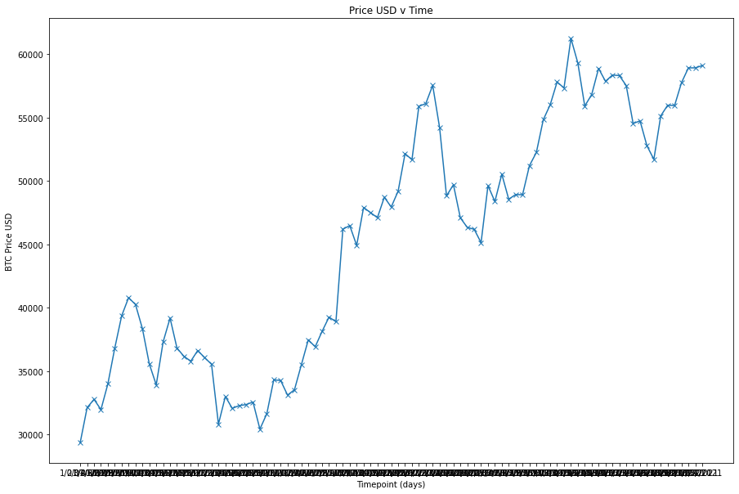
Time Series Visualisation

Slide 7
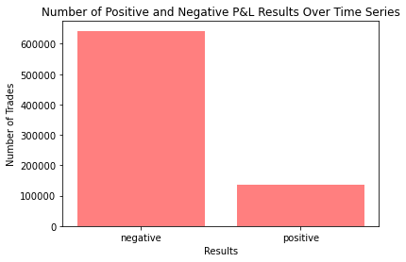
Negative v Positive P&L Results
As expected the results overwhelmingly show the disproportionate negative results achieved by entering into short positions on Bitcoin over The Time Series.
Of the 778,128 trades taken:
642,589 resulted in a negative P&L
135,539 resulted in a positive P&L
Shorting over this time series was NOT profitable

Slide 8
P&L Descriptive Statistics
The most telling statistic from the descriptive statistics on the P&L column is the mean.
The mean demonstrates that on average the shorting strategy yielded an average returns of -$9940.20 on a one for one basis. Absent of risk management.
Significant losses of this sort highlight the dangers of shorting in a market in a strong up trend particularly one that is volatile.
 | P&L
Count | 778128
Mean | -9940.2
Std | 9468.31
Min | -32643.65
25% | -17526.33
50% | -9682.31
75% | -1866.91
max | 15086.31

Slide 9
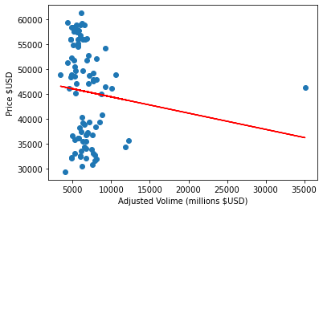
Regression Analysis: Price v Volume
A regression analysis was conducted to test the relationship between volume as the (x) or independent variable and price as the (y) dependent variable.
The correlation between the two variables was found to be -0.11% which is a weak negative relationship. (P-value = 2.71E-36, statistically significant).
This may mean that fluctuations in TOTAL volume on the buy side or sell side have little effect on price.

Slide 10
In Conclusion
This analysis has demonstrated that over the Time Series where there is a macro uptrend in place, it is statistically speaking unlikely and unprofitable to seek short positions over longer or shorter time horizons.
Using this analysis, the perils of short selling can be seen. Absent of risk management the losses can be theoretically unlimited.
Although it may seem obvious to avoid short positions during strong price movements the prevalence of short interest in the market at any given time is significant.
IT IS SAFER TO TRADE WITH THE TREND

